Slide 1
A grain of salt
Joren Janzing

Slide 2
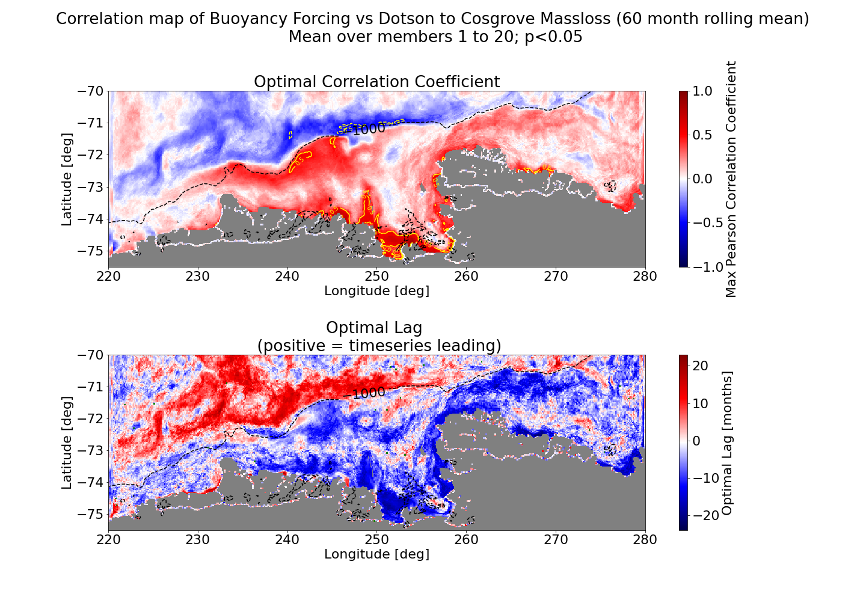
Results: forcing
Buoyancy forcing: coastal processes could play a role…

Slide 3
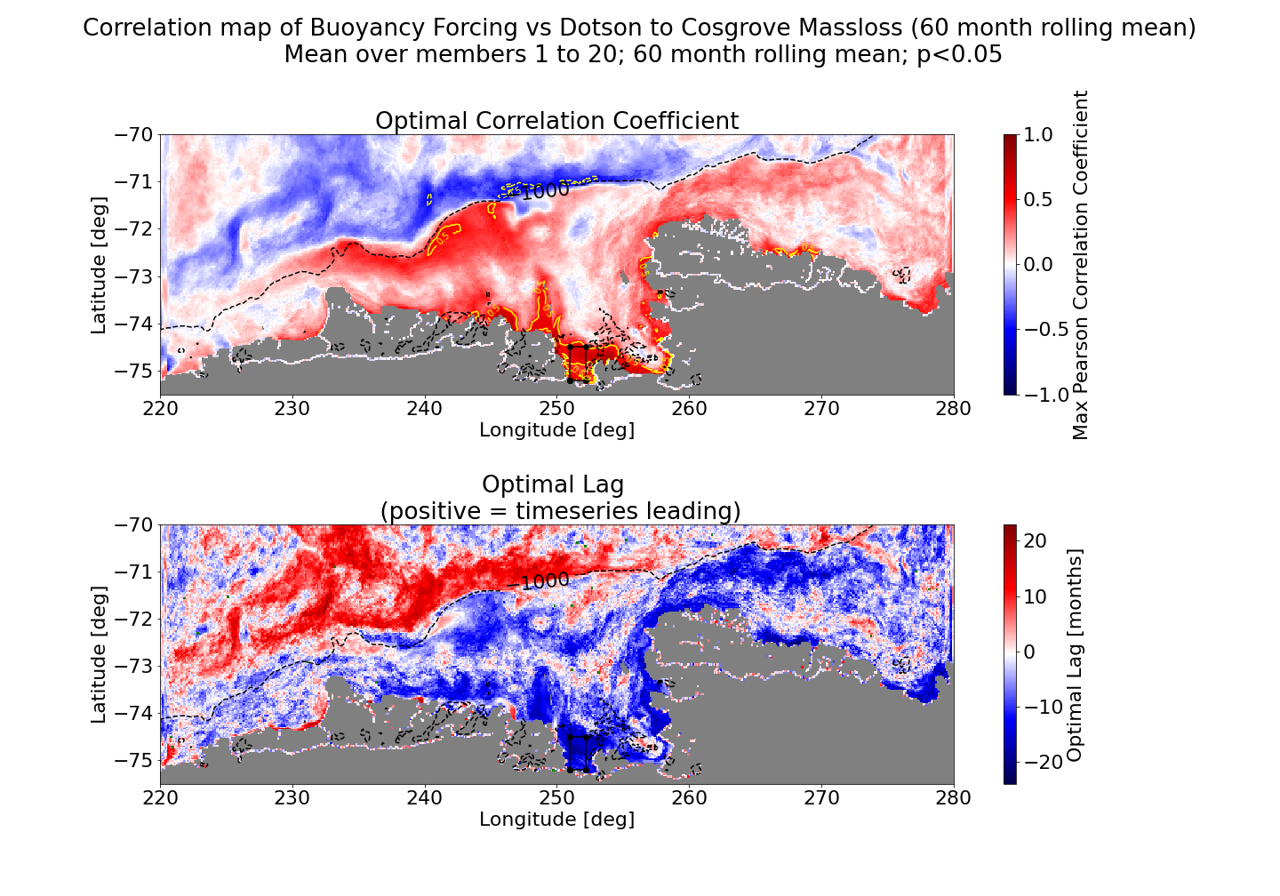

Slide 4
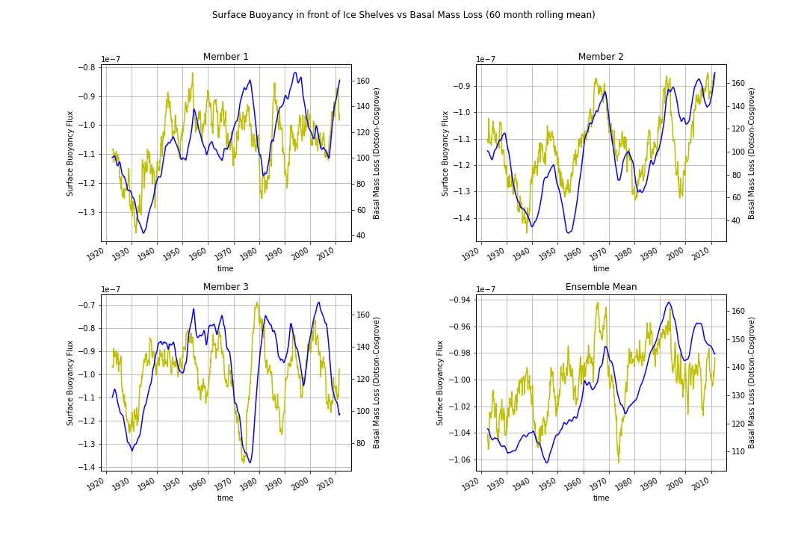

Slide 5
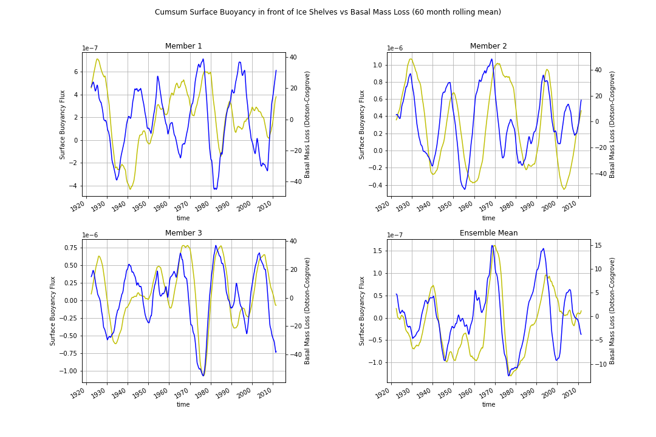

Slide 6
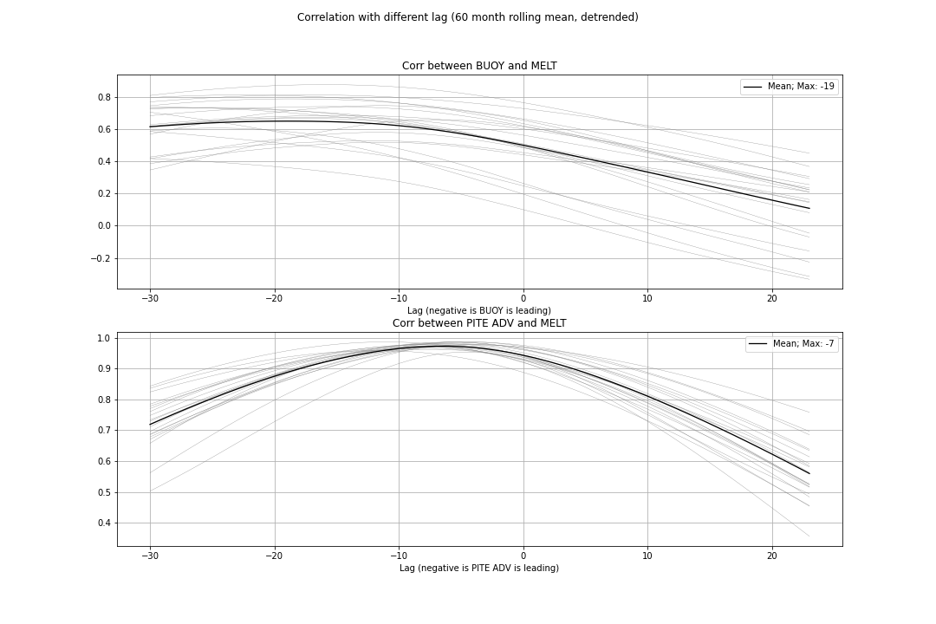

Slide 7
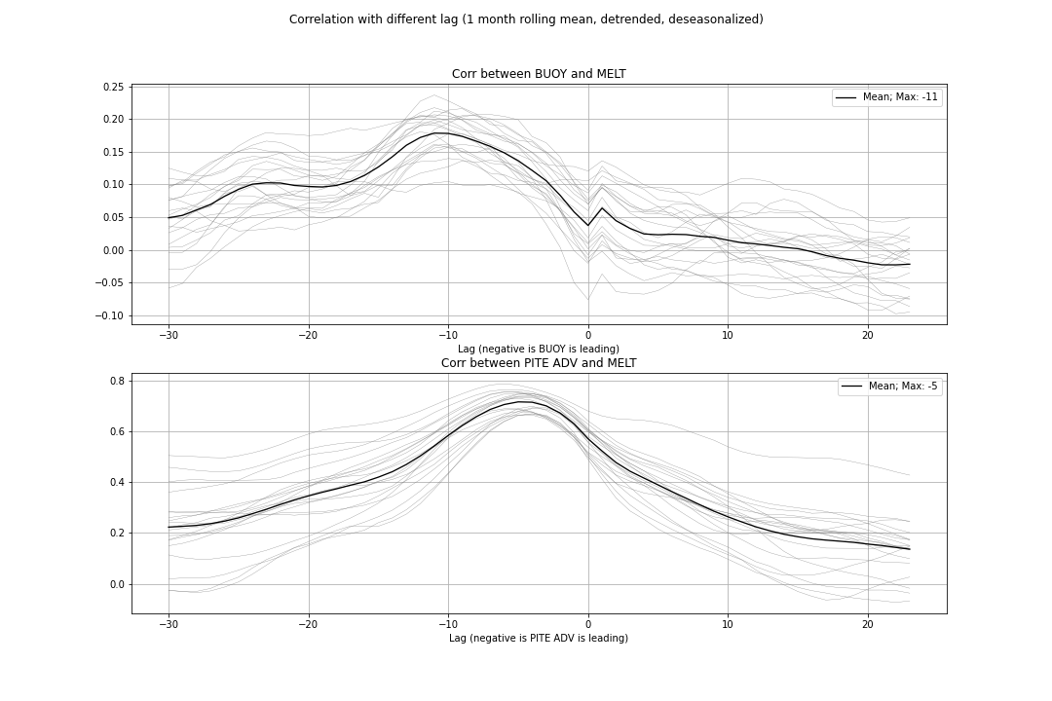
Correlations drop
when looking at
shorter term data

Slide 8
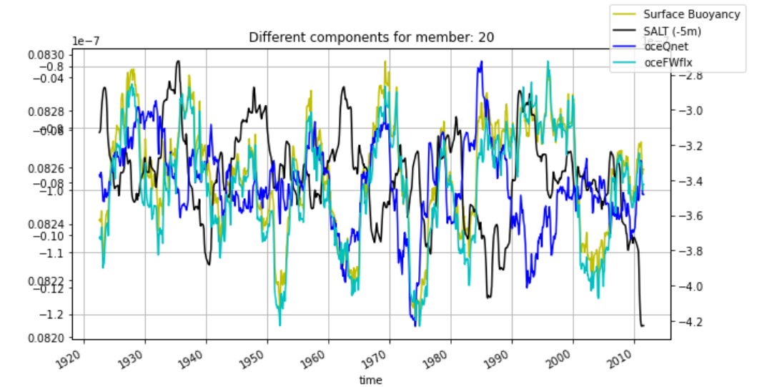

Slide 9
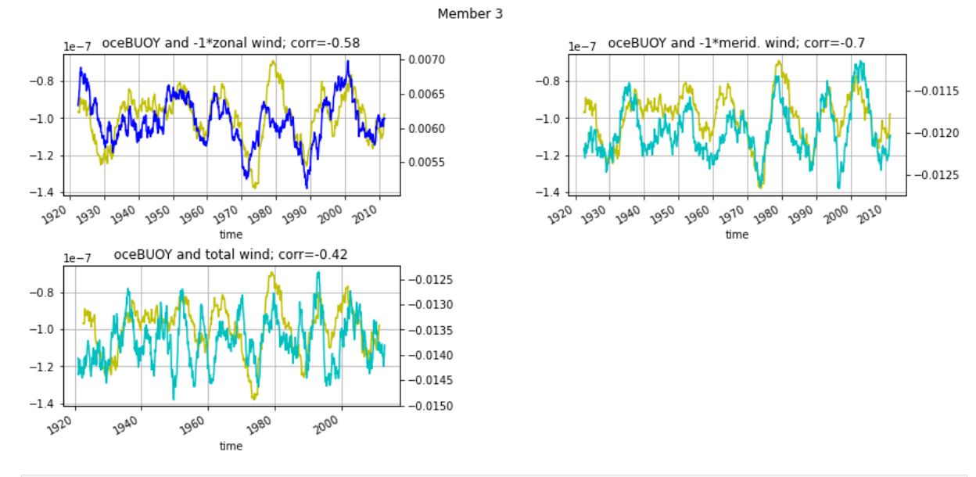

Slide 10
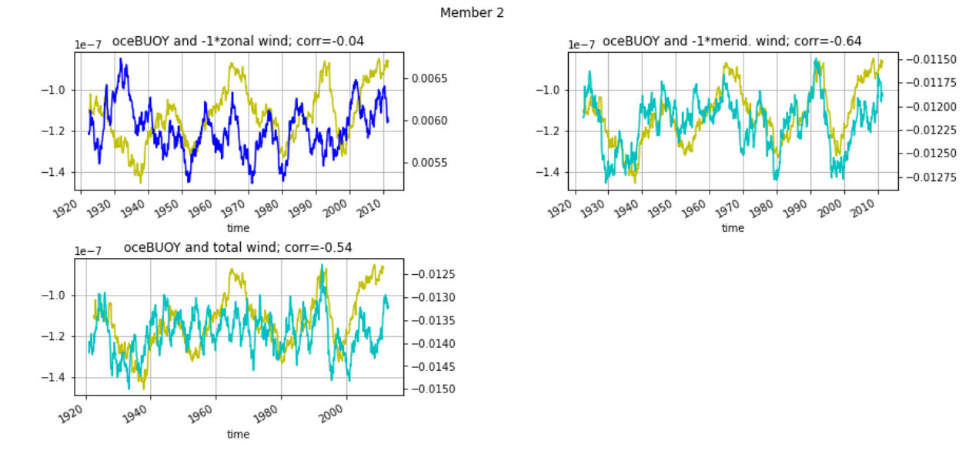

Slide 11
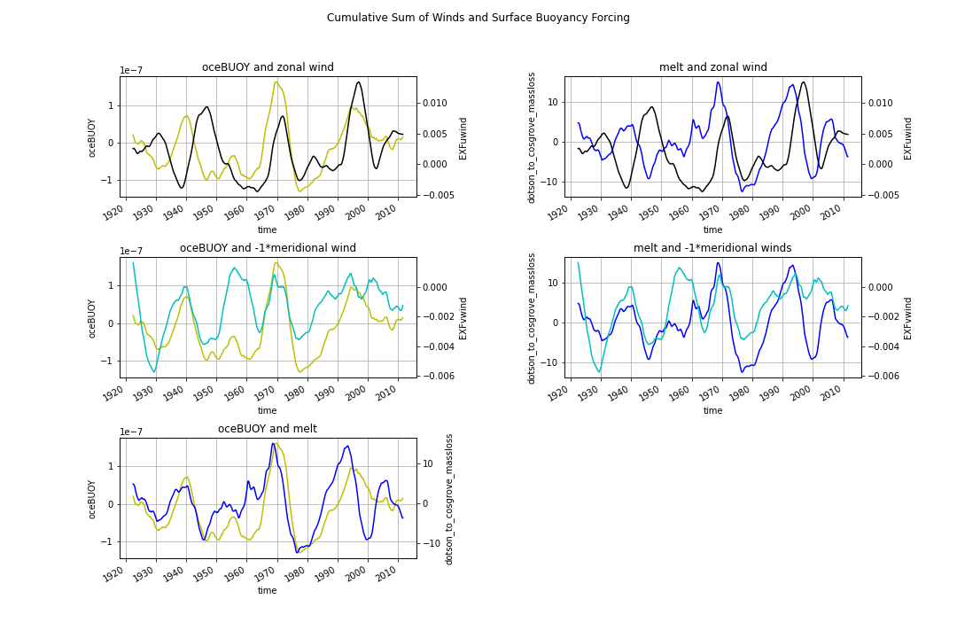

Slide 12
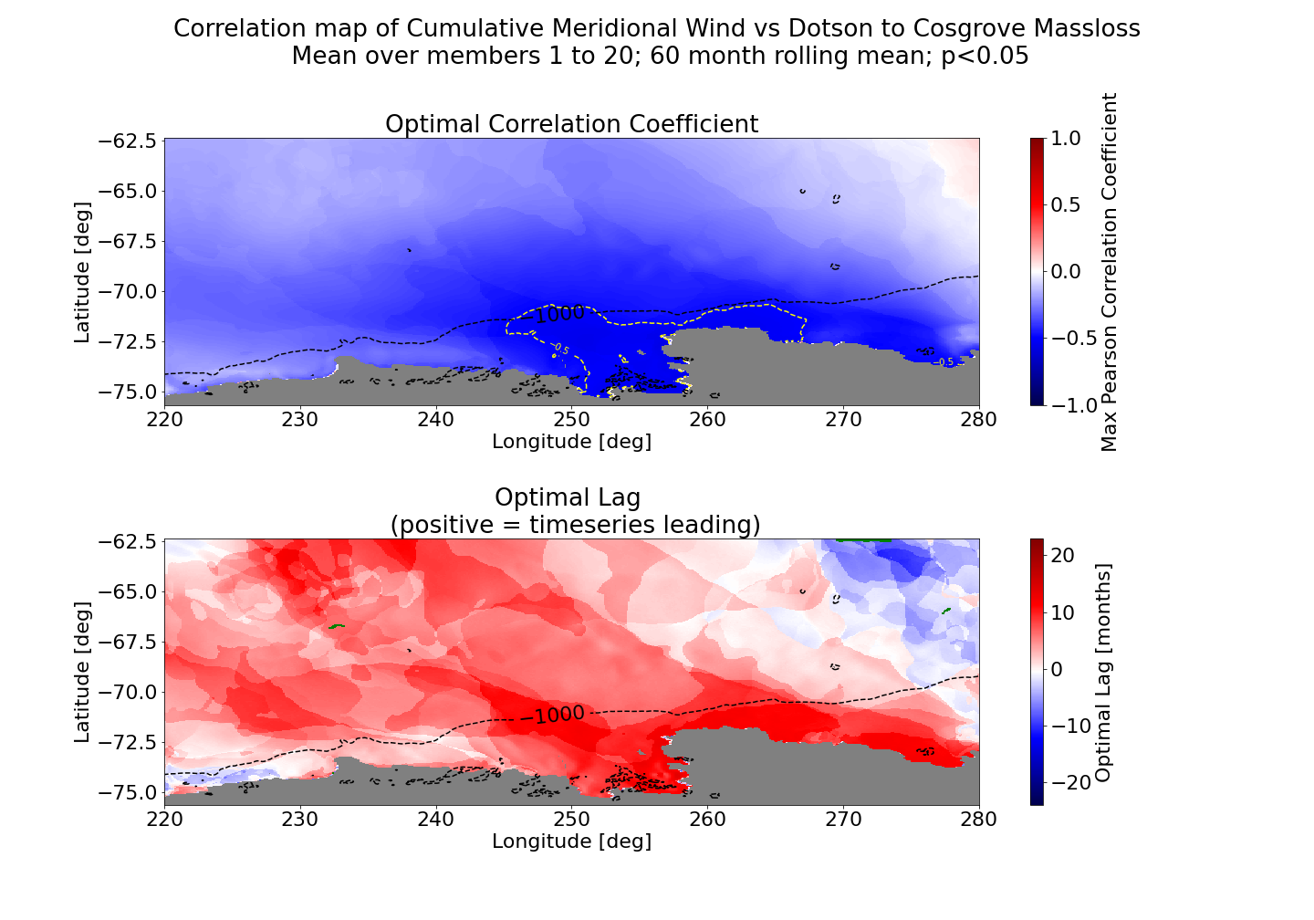

Slide 13
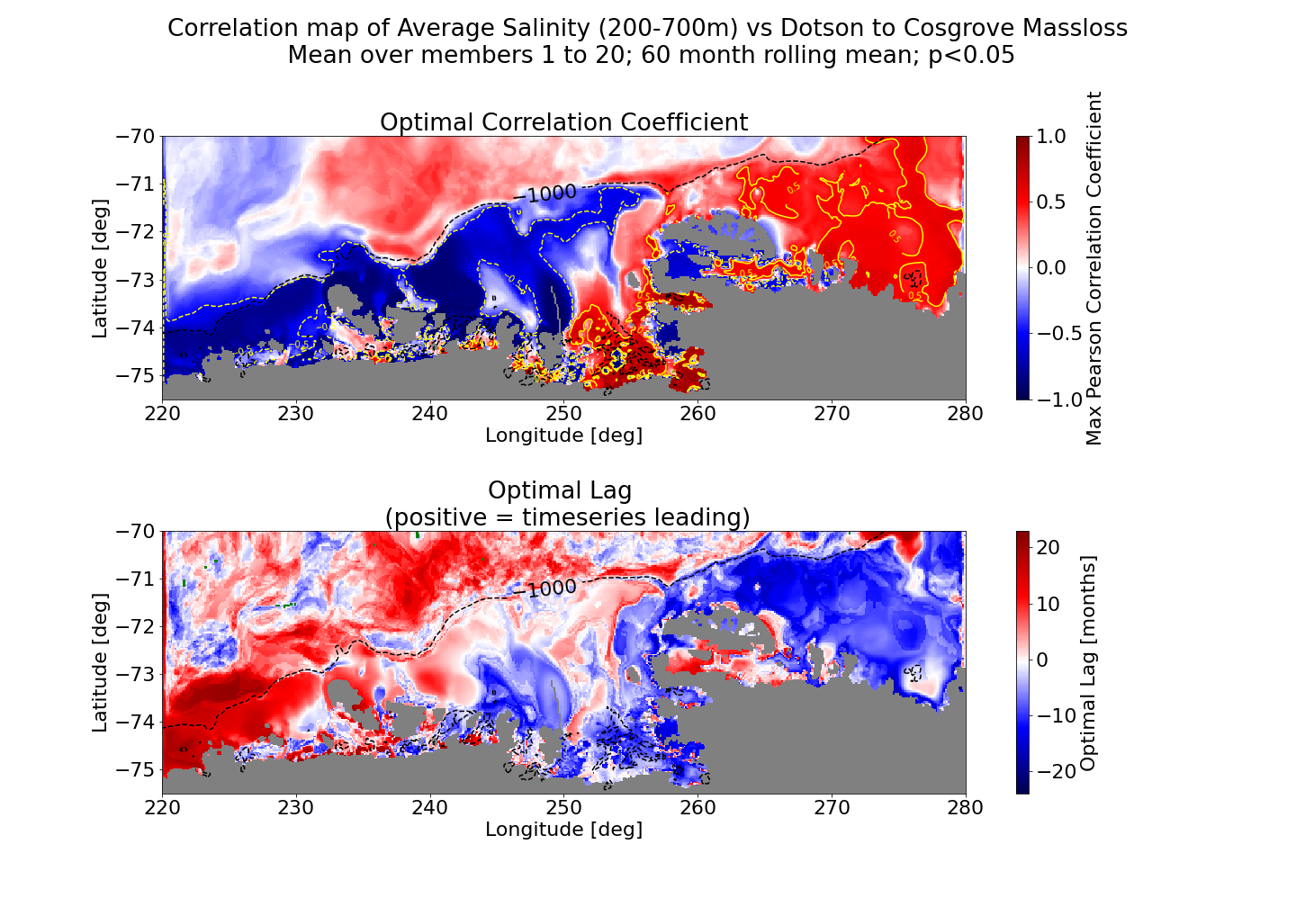

Slide 14
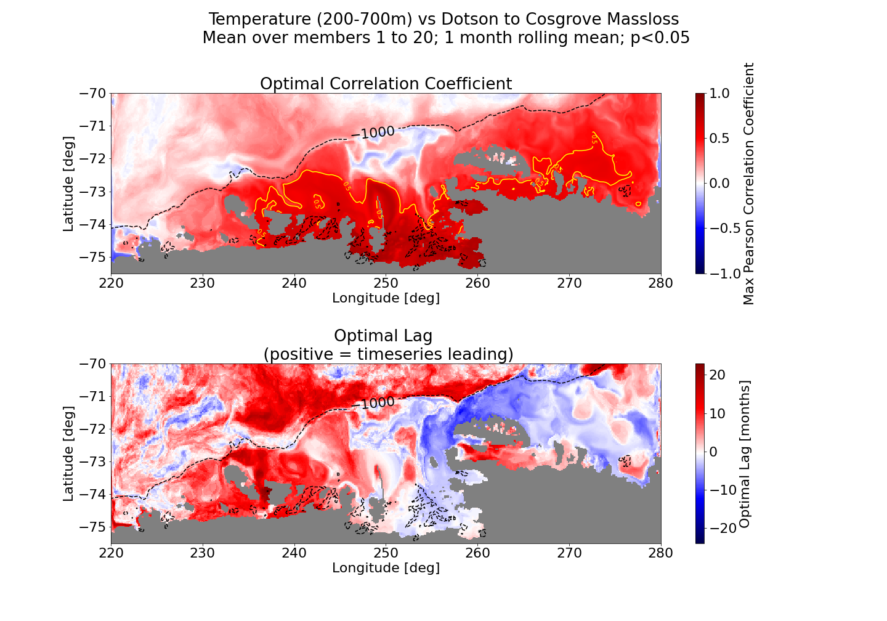

Slide 15
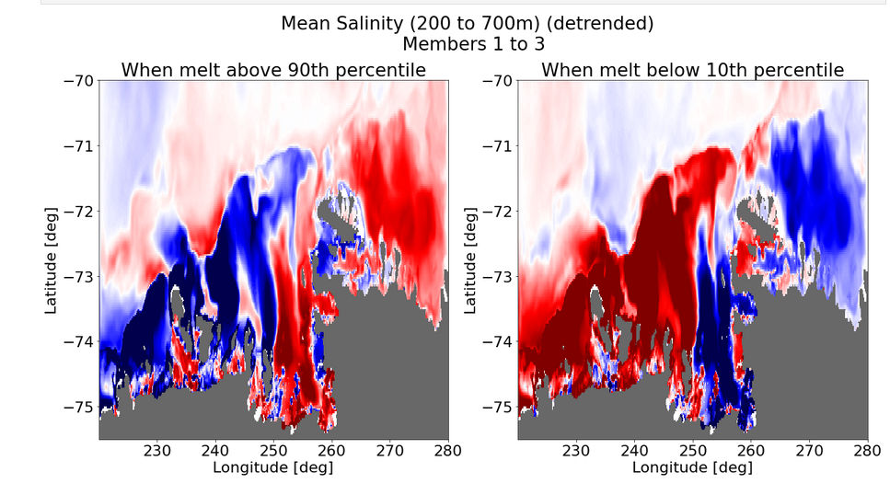

Slide 16
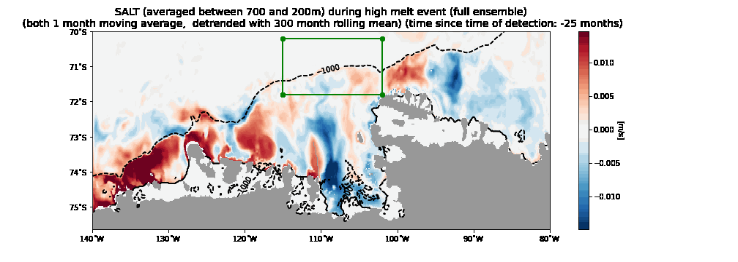

Slide 17
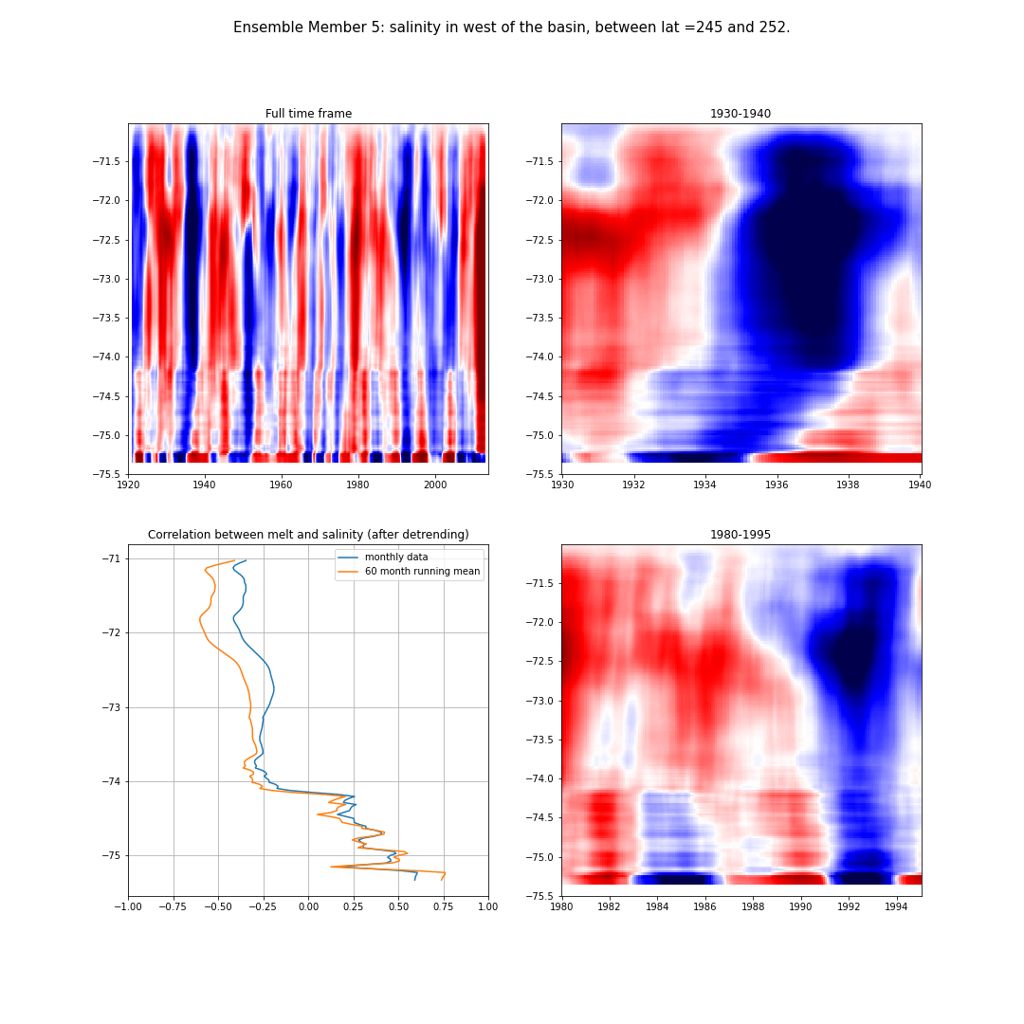
Latitude
Latitude

Slide 18
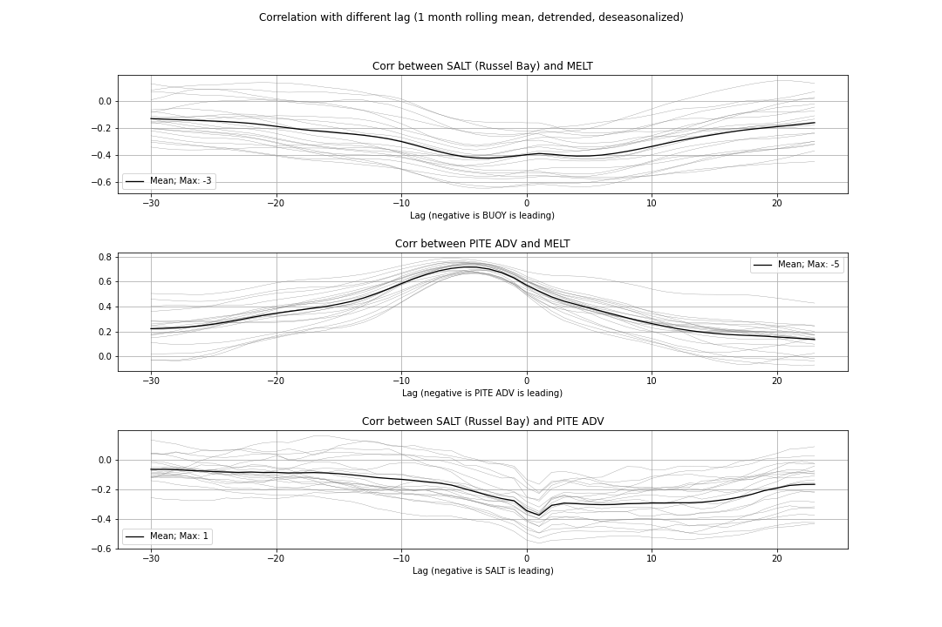

Slide 19
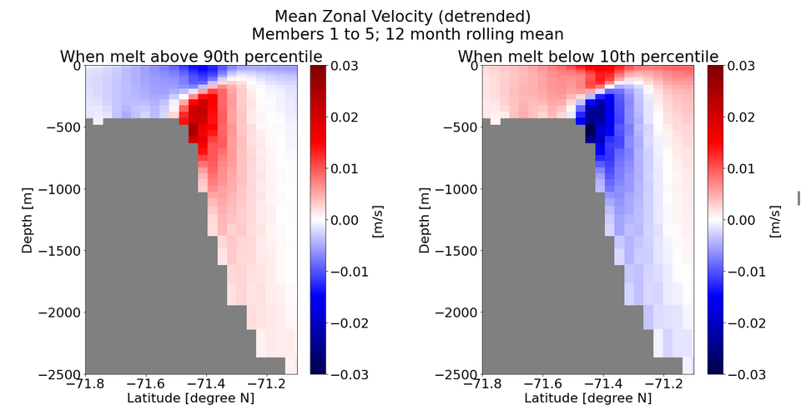
Change clearly has a baroclinic component.

Slide 20
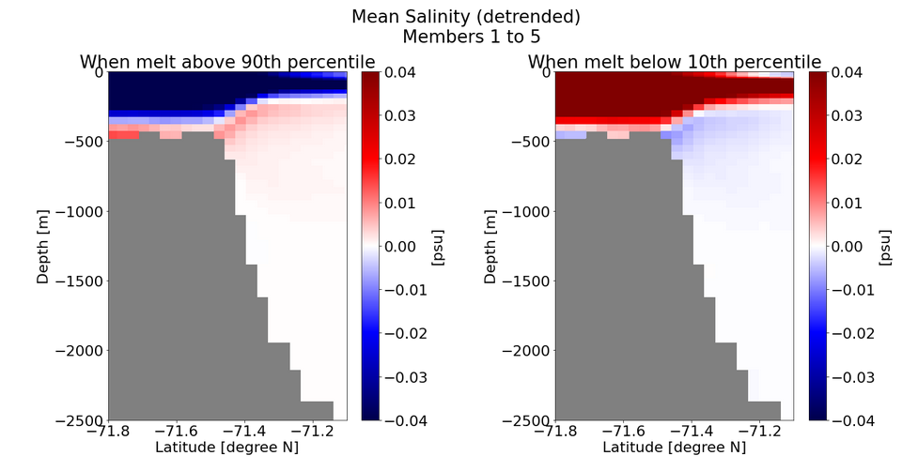

Slide 21
Conclusion
Surface Buoyancy Flux at ice front seems important.
It leads the current (although correlations between melt and heat advection are larger than between melt and buoyancy)
It seems only to work for longer running means → baroclinic adjustment?
It seems to be related to meridional wind (negative correlation).
Cumulative meridional wind on the shelf is important.
1940s: strong temperature response from ice cores→weakened katabatic winds?
Salinity on the shelf has great correlation:
Sea ice, but also ice shelve melt or CDW import?
Internal feedback loop?
Albans paper?
Causality is unclear though…
To what extent is this just the model….?

